Slide 1
Product Clustering Methodology Research & Executions
1/9/2022
Antonis, Rachel, Yuyang

Slide 2
01. Motivation and previous approach
02. Our two-step approach – STEP 1
03. Our two-step approach – STEP 2
04. Model limitations and future steps
3
5
10
15

Slide 3
01.
Motivation and Reformation Approach
Notes:
Reviewing Reformation approach - MCL and jaccard, what this project / similar projects at eki was/are trying to do with this approach (i.e. detect underlying 'styles' via customer affiliation between products). Explain fundamental problem that it always will lead to outlier clusters as there are just products that are more popular than others

Slide 4
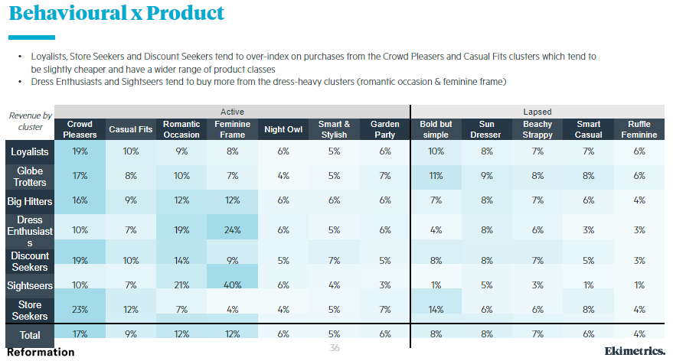
We aim to detect underlying 'styles' via customer affiliation between products
Our Aim
Interested in finding out a more efficient way to segment products and recommend by figuring out the underlying styles.
Reformation project works on both customer segmentation and product clustering to see the relation between and find the ‘styles’ customers interested in.
Fundamental problem is that it always will lead to outlier clusters as there are just products that are more popular than others

Slide 5
02.
Our 2-Step Approach (Step 1)
Notes:
First part of two-step solution to outliers: present the solution of creating similarity scores and grouping 3/3 clusters into their own nodes. Explain how it was done and maybe show example products that were grouped together to show it makes sense.
Running the jaccard and MCL, explain that there are still tiny outlier clusters and general review of output

Slide 6
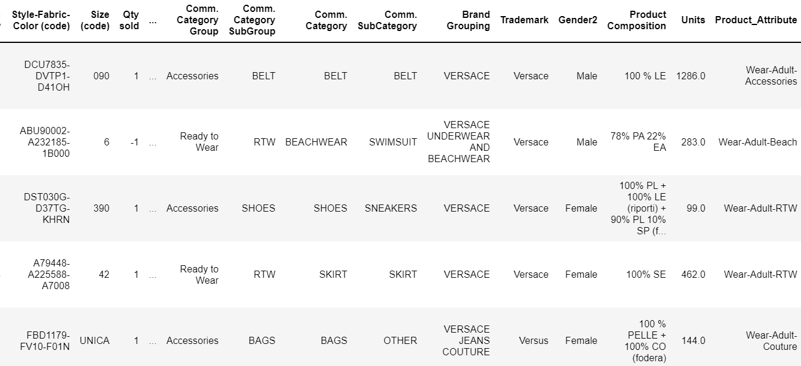
Feature engineering helps us lowers the cardinality of the data at the first step
Cardinality: 10
We took a sample of 5% of the whole data.
Classify by different occasions:
Home
Wear-Young
Wear-Adult-Business
Wear-Adult-Formal
Wear-Adult-Fitness
Wear-Adult-Beach
Wear-Adult-Lounge/Underwear
Wear-Adult-Accessories
Wear-Adult-RTW (ready to wear)
Wear-Adult-Couture
Rooms for Improvement
More specific classification for home products.
Lower cardinality of ‘colour’ and combines with the string created.

Slide 7
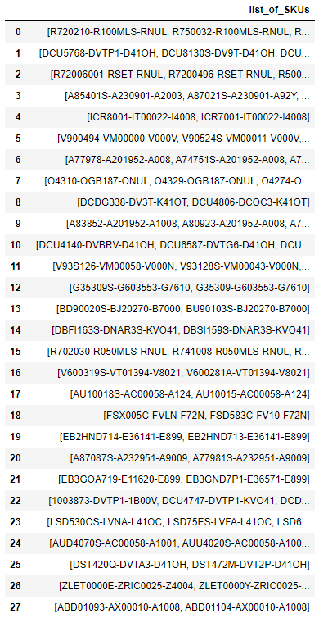
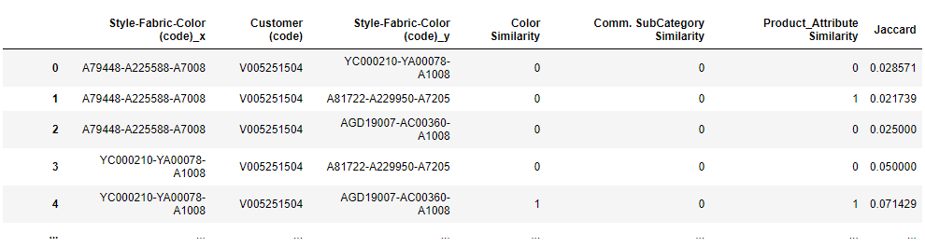
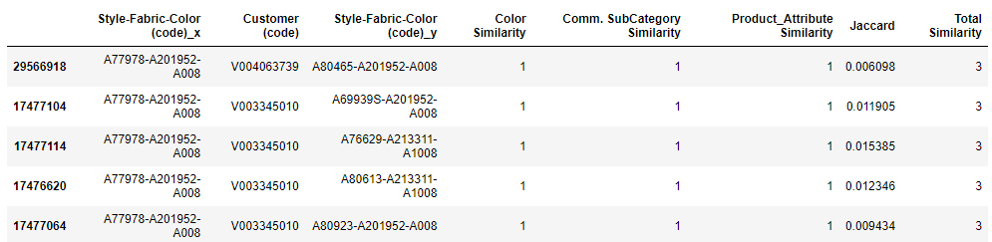
Products were paired by purchases, and products with the maximum similarity score were grouped together.
Rooms for Improvement
Assign a non-binary score
Further feature engineering
Notes:
Customer behaviour is a central focus – products were paired based on common purchases.
Similarity score was calculated based on features – 1 is matching, 0 if not.
Similarity indices summed up for each pair. Products with maximum score were grouped together into one single node.
Turned it into a dataframe, where each row represents a grouped SKU.
Improvements: Assigning a non-binary score, or further feature engineering. E.g. colours probably have many names – total of 7456 unique values in the colours tab (I cannot think of 7456 colours). If lowercase, 6843. If remove all space, then it is 6635. Feature engineering to decrease the categories.
baby pink-baby pink-versace gold
white – black vs white-black

Slide 8
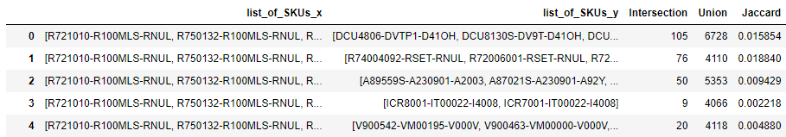
Jaccard scores for pairs of products were calculated to be used as the weights for Markov clustering.

Slide 9
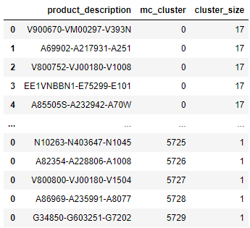
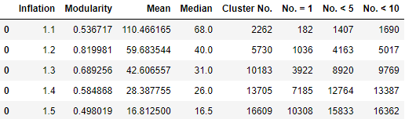
Markov Clustering was applied and a dataframe with cluster size and cluster number was obtained
Using a loop, find the optimal inflation and expansion parameter.
Using those parameters, run the algorithm and get the dataframe with the products and their clusters.
Notes:
234563 vs 182219

Slide 10
03.
Our 2-Step Approach (Step 2)
Notes:
Second part of two-step solution to outliers: how the 'Toni' method can improve the business understanding of them

Slide 11
Step 2: Merge clusters using the Jaccard scores of their products
Algorithm:
Calculate Jaccard score of all product combinations across different clusters (~33k products & 29m product-pairs)
Get the average Jaccard score for all clusters-pairs (~6k clusters & 670k cluster-pairs)
Starting from smallest cluster, examine its average Jaccard score with all the available clusters and merge with cluster whose average Jaccard score is the highest between them
Repeat until the desired number of clusters is reached (Deciding factors: well-defined clusters that make business sense)
Cluster 0 (smallest)
Cluster 1
Cluster 910
Cluster 2300
Cluster 4600
Avg Jaccard score :0.90
Avg Jaccard score :0.50
Avg Jaccard score :0.04
Avg Jaccard score :0.12

Slide 12
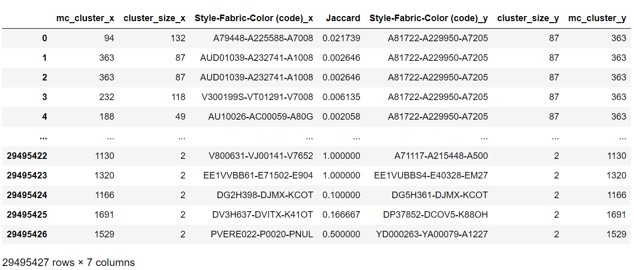
We calculate the Jaccard score of all 29m different product combinations across all cluster pairs
initial_df

Slide 13
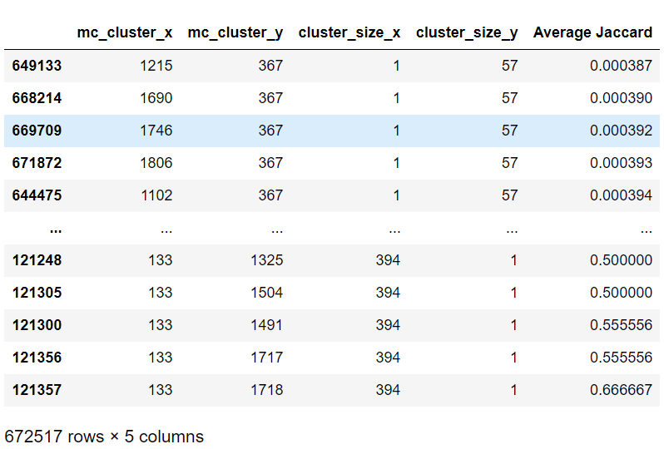
We calculate the average Jaccard score of the product combinations for all the unique cluster combinations (~670 000 different combinations)
Unique cluster combination
average_df

Slide 14
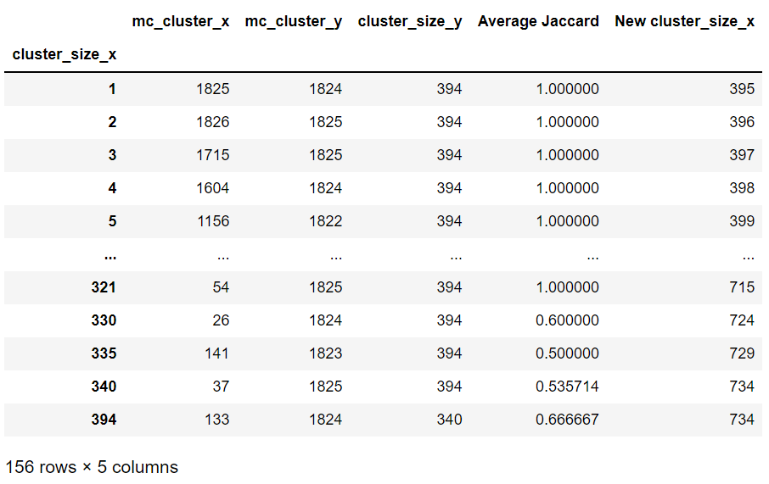



We get the max Jaccard score for each different cluster size and start merging the smallest cluster to its most similar cluster
Cluster 1825 is merged to Cluster 1824 and its new size is the combined of the two (395)
max_df

Slide 15
04.
Model Limitations and Future Steps
Notes:
Ideally show real examples from our clusters, about how they make business sense and could be interpreted by Versace

Slide 16
What problems we haven’t fixed and what can we do in the future?
Problems:
Time issues (runs for days)
Memory issues (need to create maaanny new files to run the loop, and very manual)
Possible solutions:
Cloud storage can be used in the future for memory issues. (Maybe Azure)
Current method to cluster the clusters may be updated by other deep learning methods to reduce running time.

Slide 18
Resources

Slide 19
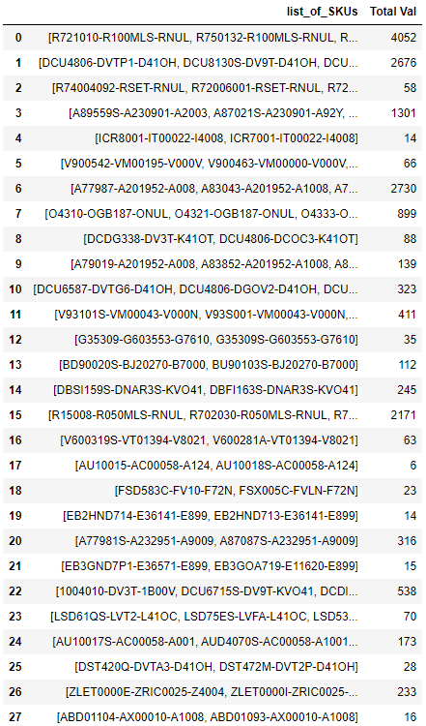
Yuyang’s random screenshots

Slide 20
Yuyang’s random screenshots

Slide 21
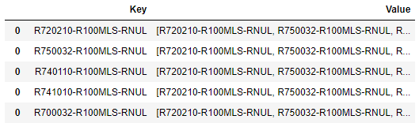
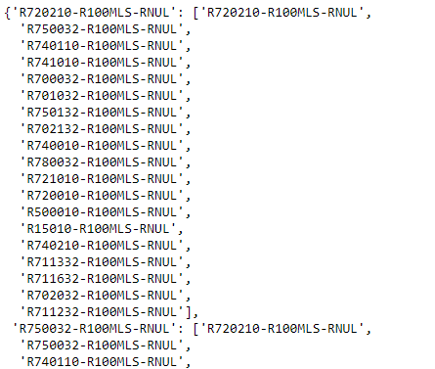
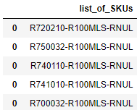
Yuyang’s random screenshots
Notes:
Mapping dictionary

Slide 22
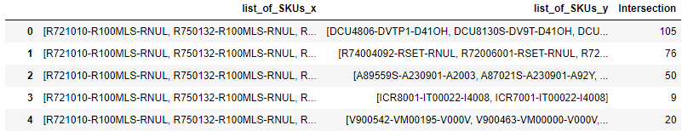
Yuyang’s random screenshots

Slide 23
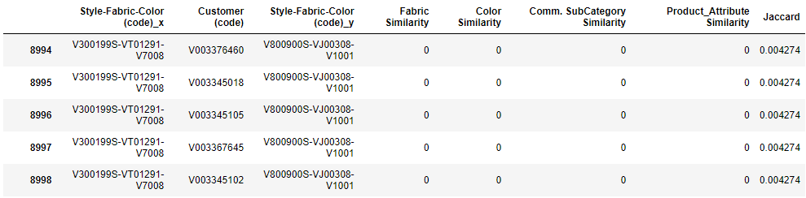
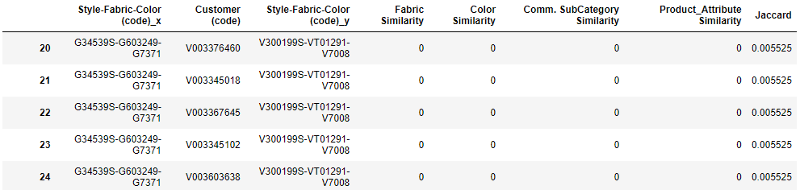
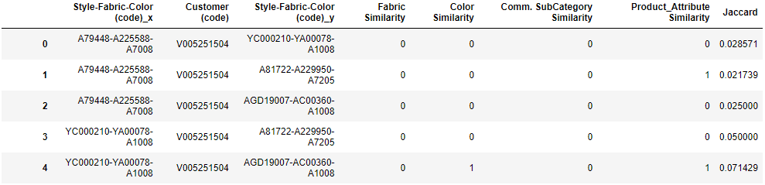
Yuyang’s random screenshots
Notes:
a b c

Slide 24
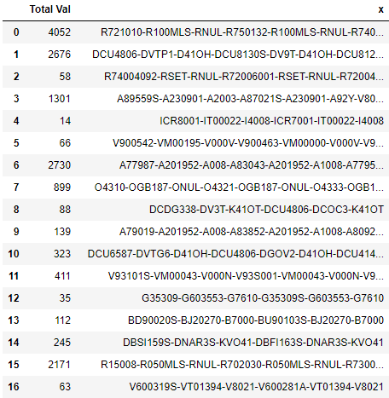
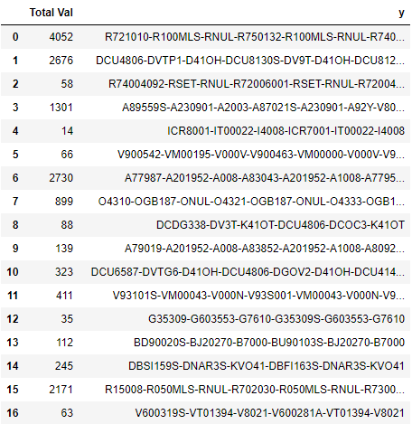
Yuyang’s random screenshots

Slide 25
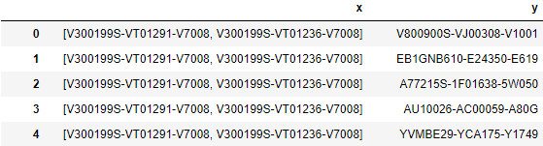
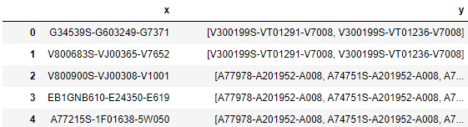
Yuyang’s random screenshots

Slide 26
Previous feedback:
The content was interesting and could have been more well adapted to the audience by explaining the existing client work in more details, as not everyone might have seen those slides earlier. Also, content would have been aided by some visual prompts in the slides for more information-dense topics (example, Clustering particularly to MMM-focused consultants)
The posture was not distracting for the audience and gestures were mostly appropriate and not taking away the audience concentration.
The flow of information in the slides was logical and well structured. Engaging tone but could slow down when presenting, and make sure to stop and ask the audience if they have any questions
The 'Next Steps' should only be for future steps, and then a different slide for what has been done so far. Also, the transition between presenters was a bit distracting, so best would be to have one person speak continuously for a few slides and then let the other speak.
It was a bit unclear of what clustering has been decided on and what were the results but some of the questions related to clustering were taken up after the presentations and were appropriately answered.
Do add any links/citations to the research papers or tools that have been referred to in your work. It makes things easier to trace back the source of the content or the work done, in future.

Slide 27
A mapping dictionary was created and used to replace individual SKUs with the list of grouped SKUs.
Notes:
From the dataframe previously, a mapping dictionary was created. With it, the x and y columns were remapped.
Grouped into a list and replaced it in the dataframe.
Include a Markov clustering image. Each dot is a node and each cluster is a colour, so … (include explanation).
There are gonna be complicated stuff in the methodology but do not say it.

